Slide 1
Text and Web Mining

Slide 2
Learning Objectives
Describe text mining and understand the need for text mining
Differentiate between text mining, Web mining and data mining
Understand the different application areas for text mining
Know the process of carrying out a text mining project
Understand the different methods to introduce structure to text-based data

Slide 3
Learning Objectives
Describe Web mining, its objectives, and its benefits
Understand the three different branches of Web mining
  Web content mining
  Web structure mining
  Web usage mining
Understand the applications of these three mining paradigms

Slide 4
Opening Vignette:
“Mining Text for Security and Counterterrorism”
What is MITRE?
Problem description
Proposed solution
Results
Answer and discuss the case questions

Slide 5
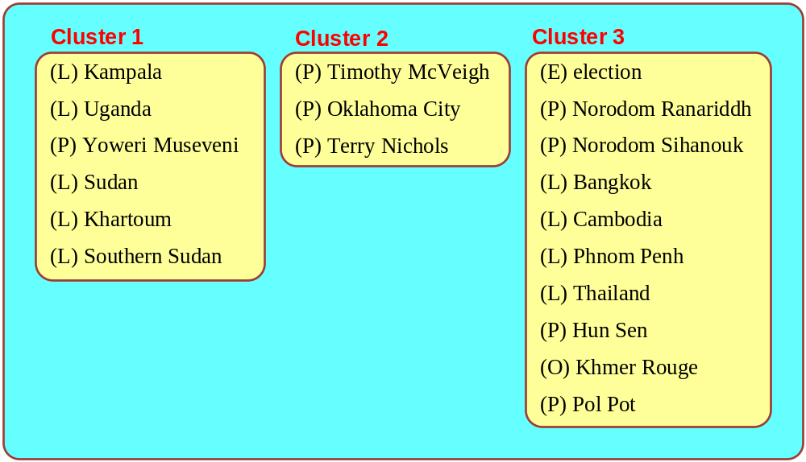
Opening Vignette:
Mining Text For Security…

Slide 6
Text Mining Concepts
85-90 percent of all corporate data is in some kind of unstructured form (e.g., text)
Unstructured corporate data is doubling in size every 18 months
Tapping into these information sources is not an option, but a need to stay competitive
Answer: text mining
  A semi-automated process of extracting knowledge from unstructured data sources
  a.k.a. text data mining or knowledge discovery in textual databases

Slide 7
Data Mining versus Text Mining
Both seek for novel and useful patterns
Both are semi-automated processes
Difference is the nature of the data:
  Structured versus unstructured data
  Structured data: in databases
  Unstructured data: Word documents, PDF files, text excerpts, XML files, and so on
Text mining – first, impose structure to the data, then mine the structured data

Slide 8
Text Mining Concepts
Benefits of text mining are obvious especially in text-rich data environments
  e.g., law (court orders), academic research (research articles), finance (quarterly reports), medicine (discharge summaries), biology (molecular interactions), technology (patent files), marketing (customer comments), etc.
Electronic communization records (e.g., Email)
  Spam filtering
  Email prioritization and categorization
  Automatic response generation

Slide 9
Text Mining Application Area
Information extraction
Topic tracking
Summarization
Categorization
Clustering
Concept linking
Question answering

Slide 10
Text Mining Terminology
Unstructured or semistructured data
Corpus (and corpora)
Terms
Concepts
Stemming
Stop words (and include words)
Synonyms (and polysemes)
Tokenizing

Slide 11
Text Mining Terminology
Term dictionary
Word frequency
Part-of-speech tagging
Morphology
Term-by-document matrix
  Occurrence matrix
Singular value decomposition
  Latent semantic indexing

Slide 12
Text Mining for Patent Analysis
(see Applications Case 7.2)
What is a patent?
  “exclusive rights granted by a country to an inventor for a limited period of time in exchange for a disclosure of an invention”
How do we do patent analysis (PA)?
Why do we need to do PA?
  What are the benefits?
  What are the challenges?
How does text mining help in PA?

Slide 13
Natural Language Processing (NLP)
Structuring a collection of text
  Old approach: bag-of-words
  New approach: natural language processing
NLP is …
  a very important concept in text mining
  a subfield of artificial intelligence and computational linguistics
  the studies of "understanding" the natural human language
Syntax versus semantics based text mining

Slide 14
Natural Language Processing (NLP)
What is “Understanding” ?
  Human understands, what about computers?
  Natural language is vague, context driven
  True understanding requires extensive knowledge of a topic
  Can/will computers ever understand natural language the same/accurate way we do?

Slide 15
Natural Language Processing (NLP)
Challenges in NLP
  Part-of-speech tagging
  Text segmentation
  Word sense disambiguation
  Syntax ambiguity
  Imperfect or irregular input
  Speech acts
Dream of AI community
  to have algorithms that are capable of automatically reading and obtaining knowledge from text

Slide 16
Natural Language Processing (NLP)
WordNet
  A laboriously hand-coded database of English words, their definitions, sets of synonyms, and various semantic relations between synonym sets
  A major resource for NLP
  Need automation to be completed
Sentiment Analysis
  A technique used to detect favorable and unfavorable opinions toward specific products and services
  See Application Case 7.3 for a CRM application

Slide 17
NLP Task Categories
Information retrieval
Information extraction
Named-entity recognition
Question answering
Automatic summarization
Natural language generation and understanding
Machine translation
Foreign language reading and writing
Speech recognition
Text proofing
Optical character recognition

Slide 18
Text Mining Applications
Marketing applications
  Enables better CRM
Security applications
  ECHELON, OASIS
  Deception detection (…)
Medicine and biology
  Literature-based gene identification (…)
Academic applications
  Research stream analysis

Slide 19
Text Mining Applications
Application Case 7.4: Mining for Lies
Deception detection
  A difficult problem
  If detection is limited to only text, then the problem is even more difficult
The study
  analyzed text based testimonies of person of interests at military bases
  used only text-based features (cues)

Slide 20
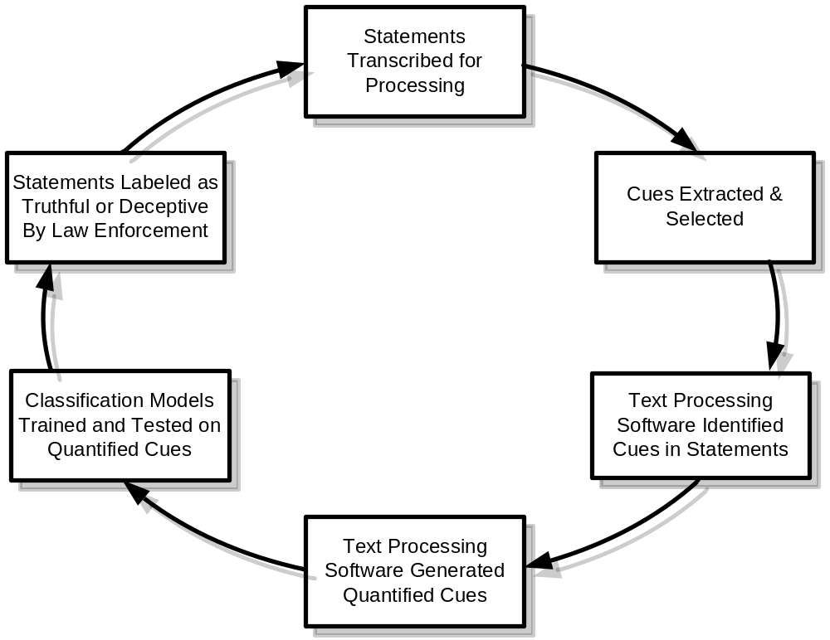
Text Mining Applications
Application Case 7.4: Mining for Lies

Slide 21
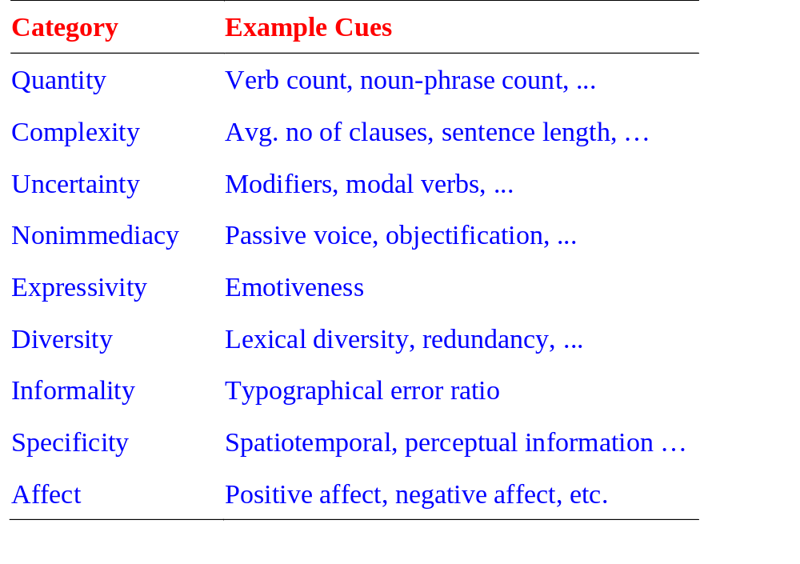
Text Mining Applications
Application Case 7.4: Mining for Lies

Slide 22
Text Mining Applications
Application Case 7.4: Mining for Lies
  371 usable statements are generated
  31 features are used
  Different feature selection methods used
  10-fold cross validation is used
  Results (overall % accuracy)
    Logistic regression 67.28
    Decision trees 71.60
    Neural networks 73.46

Slide 23
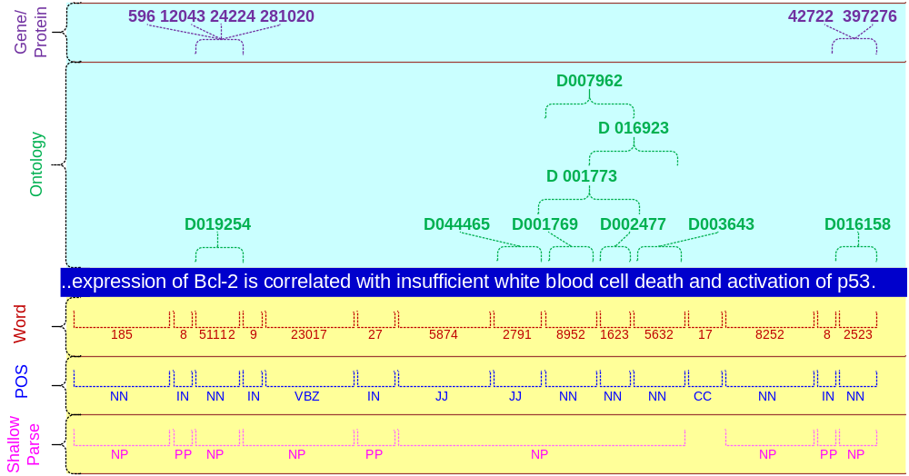
Text Mining Applications
(gene/protein interaction identification)

Slide 24
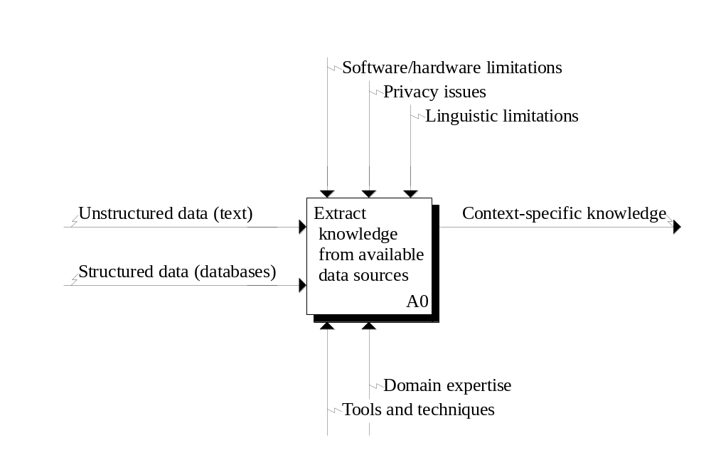
Text Mining Process
Context diagram for the text mining process

Slide 25
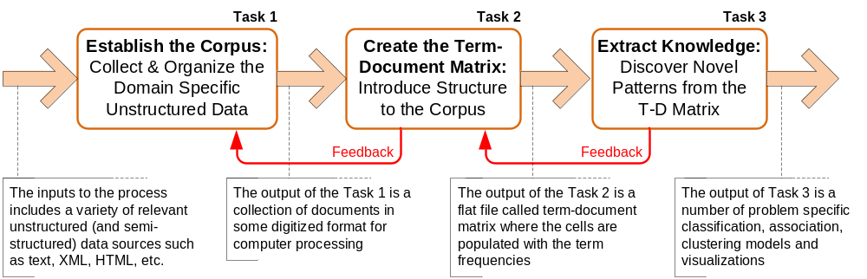
Text Mining Process
The three-step text mining process

Slide 26
Text Mining Process
Step 1: Establish the corpus
  Collect all relevant unstructured data (e.g., textual documents, XML files, emails, Web pages, short notes, voice recordings…)
  Digitize, standardize the collection (e.g., all in ASCII text files)
  Place the collection in a common place (e.g., in a flat file, or in a directory as separate files)

Slide 27
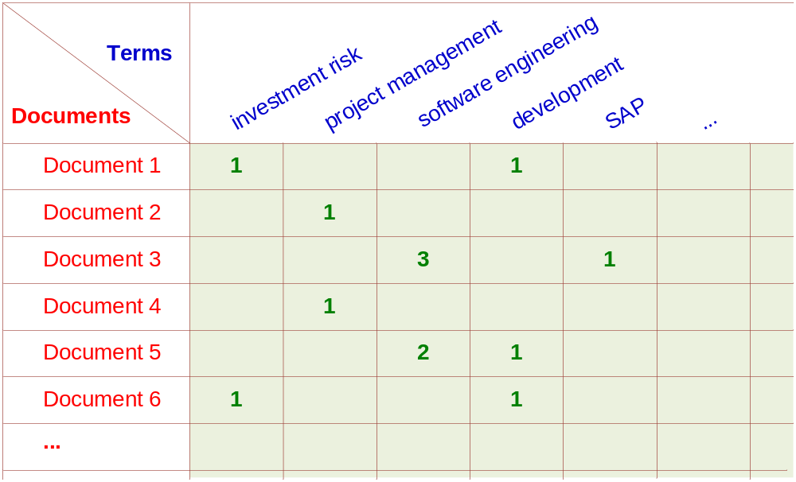
Text Mining Process
Step 2: Create the Term–by–Document Matrix

Slide 28
Text Mining Process
Step 2: Create the Term–by–Document Matrix (TDM), cont.
  Should all terms be included?
    Stop words, include words
    Synonyms, homonyms
    Stemming
  What is the best representation of the indices (values in cells)?
    Row counts; binary frequencies; log frequencies;
    Inverse document frequency

Slide 29
Text Mining Process
Step 2: Create the Term–by–Document Matrix (TDM), cont.
  TDM is a sparse matrix. How can we reduce the dimensionality of the TDM?
    Manual - a domain expert goes through it
    Eliminate terms with very few occurrences in very few documents (?)
    Transform the matrix using singular value decomposition (SVD)
    SVD is similar to principle component analysis

Slide 30
Text Mining Process
Step 3: Extract patterns/knowledge
  Classification (text categorization)
  Clustering (natural groupings of text)
    Improve search recall
    Improve search precision
    Scatter/gather
    Query-specific clustering
  Association
  Trend Analysis (…)

Slide 31
Text Mining Application
(research trend identification in literature)
Mining the published IS literature
  MIS Quarterly (MISQ)
  Journal of MIS (JMIS)
  Information Systems Research (ISR)
  Covers 12-year period (1994-2005)
  901 papers are included in the study
  Only the paper abstracts are used
  9 clusters are generated for further analysis

Slide 32
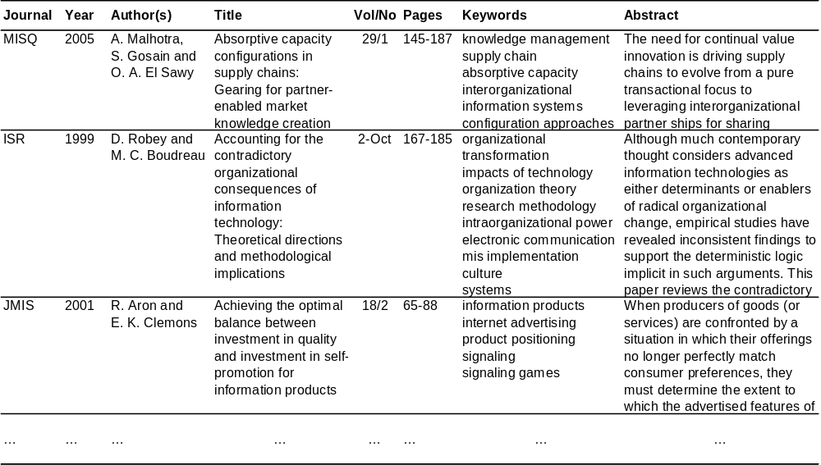
Text Mining Application
(research trend identification in literature)

Slide 33
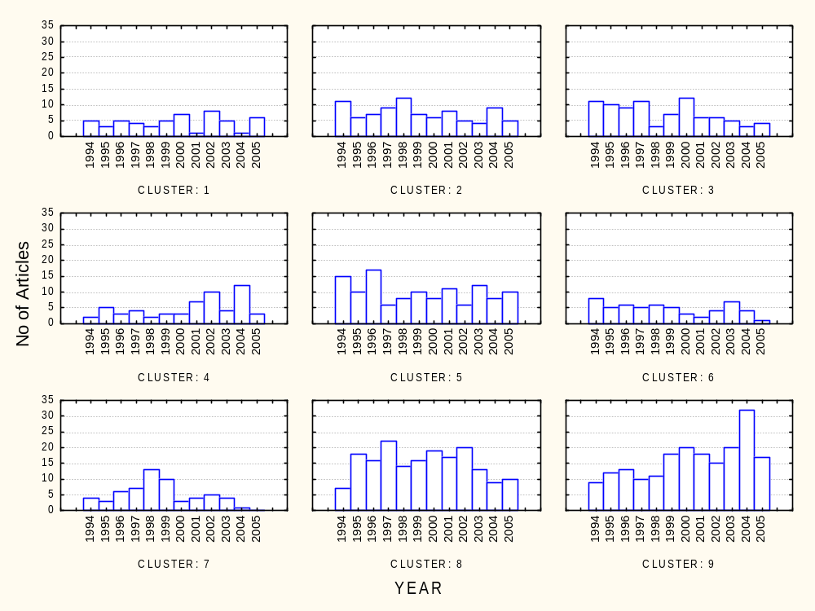
Text Mining Application
(research trend identification in literature)

Slide 34
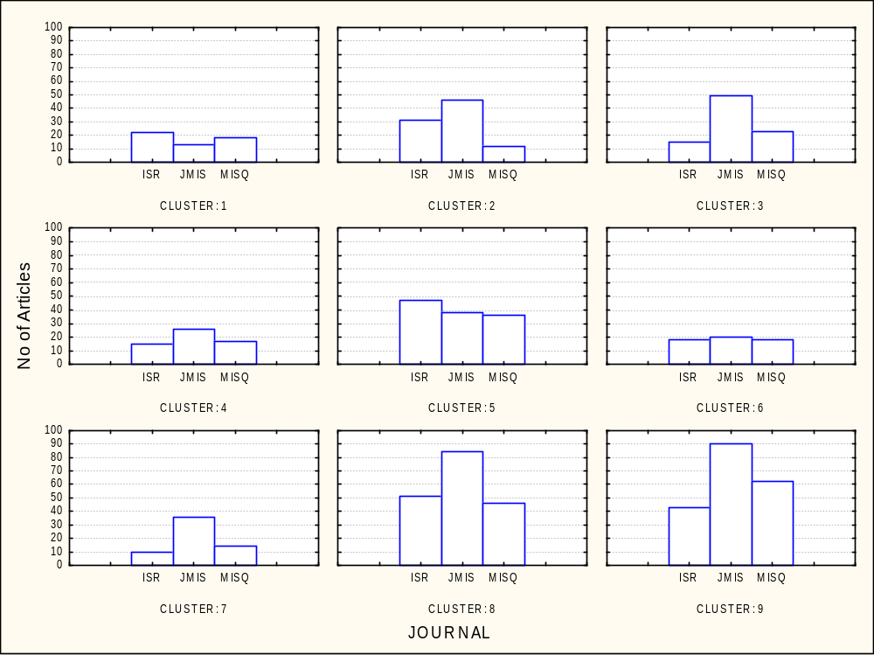
Text Mining Application
(research trend identification in literature)

Slide 35
Text Mining Tools
Commercial Software Tools
  SPSS PASW Text Miner
  SAS Enterprise Miner
  Statistica Data Miner
  ClearForest, …
Free Software Tools
  RapidMiner
  GATE
  Spy-EM, …

Slide 36
Web Mining Overview
Web is the largest repository of data
Data is in HTML, XML, text format
Challenges (of processing Web data)
  The Web is too big for effective data mining
  The Web is too complex
  The Web is too dynamic
  The Web is not specific to a domain
  The Web has everything
Opportunities and challenges are great!

Slide 37
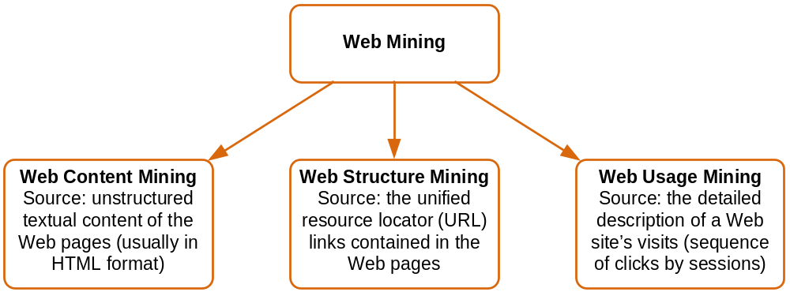
Web Mining
Web mining (or Web data mining) is the process of discovering intrinsic relationships from Web data (textual, linkage, or usage)

Slide 38
Web Content/Structure Mining
Mining of the textual content on the Web
Data collection via Web crawlers
Web pages include hyperlinks
  Authoritative pages
  Hubs
  hyperlink-induced topic search (HITS) alg

Slide 39
Web Usage Mining
Extraction of information from data generated through Web page visits and transactions…
  data stored in server access logs, referrer logs, agent logs, and client-side cookies
  user characteristics and usage profiles
  metadata, such as page attributes, content attributes, and usage data
Clickstream data
Clickstream analysis

Slide 40
Web Usage Mining
Web usage mining applications
  Determine the lifetime value of clients
  Design cross-marketing strategies across products.
  Evaluate promotional campaigns
  Target electronic ads and coupons at user groups based on user access patterns
  Predict user behavior based on previously learned rules and users' profiles
  Present dynamic information to users based on their interests and profiles…

Slide 41
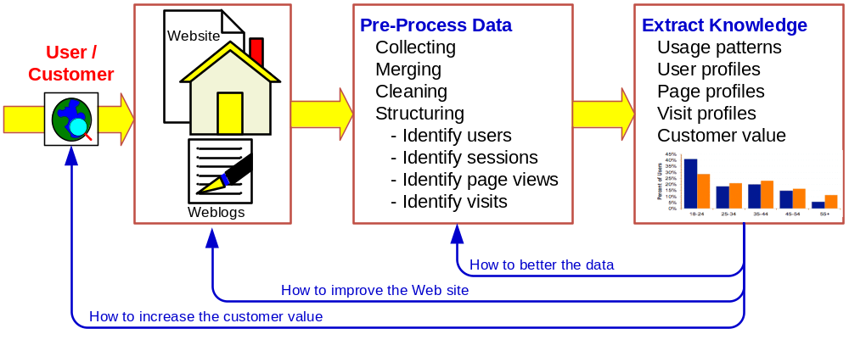
Web Usage Mining
(clickstream analysis)

Slide 42
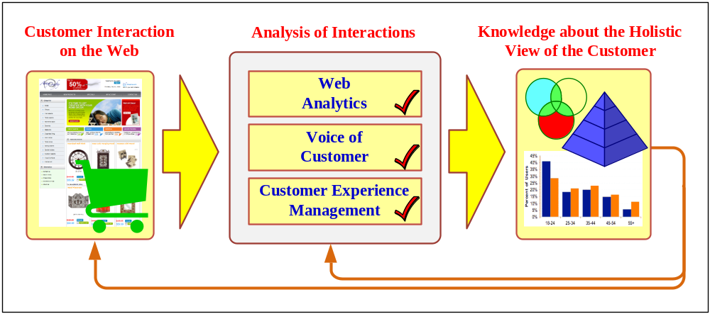
Web Mining Success Stories
Amazon.com, Ask.com, Scholastic.com, …
Website Optimization Ecosystem

Slide 43
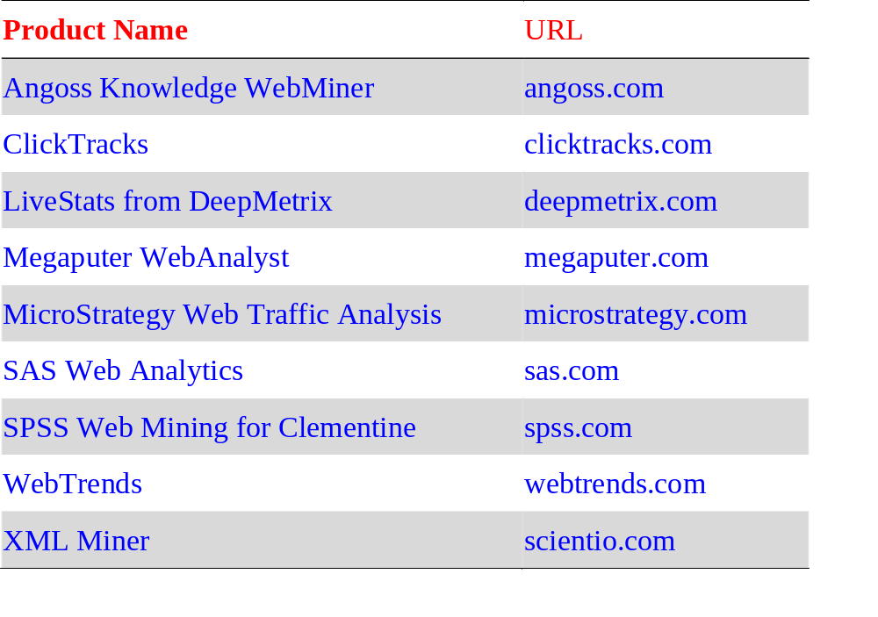
Web Mining Tools

Slide 44
End of the Chapter
Questions / comments…

Slide 45

All rights reserved. No part of this publication may be reproduced, stored in a retrieval system, or transmitted, in any form or by any means, electronic, mechanical, photocopying, recording, or otherwise, without the prior written permission of the publisher. Printed in the United States of America.
Copyright © 2011 Pearson Education, Inc.
Publishing as Prentice Hall

